Slide 1

STUDENT MANAGEMENT SYSTEM
https://github.com/sokvebolkol/midterm-php-project-sms

Slide 2


Our
Team
Project
Sokvebol Kol
Web and Mobile developer
I am a talented, ambitious and hardworking individual, with broad skills and experience in application engineering, social media
Pho Seth
Web and Mobile developer
I am very happy to be a part of developing my country through technology. My talent, skill, my hard-working will develop Cambodia back to Empire.

Slide 3
CONTENT
1
OVERVIEW
2
FEATURE
3
TECHNOLOGY
4
CONCLUSION

Slide 4
Overview
Student Management System
A student information system, student management system, school administration software or student administration system is a management information system for education establishments used to manage student data.

Slide 5
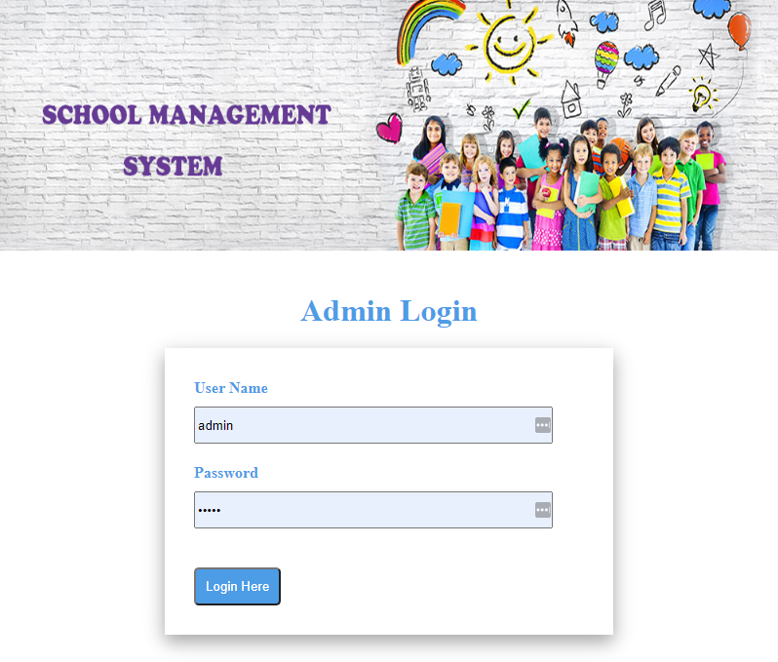
Feature
Login

Slide 6
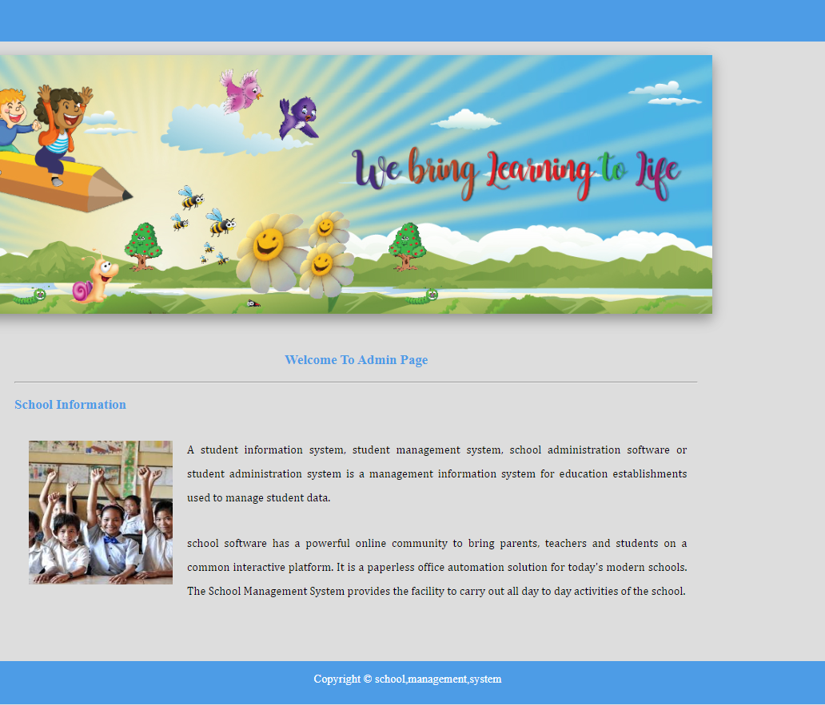
Welcome
Page

Slide 7
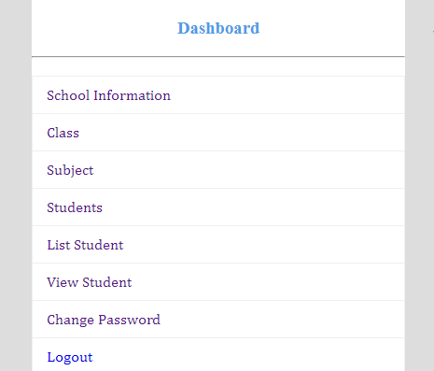
Dashboard

Slide 8
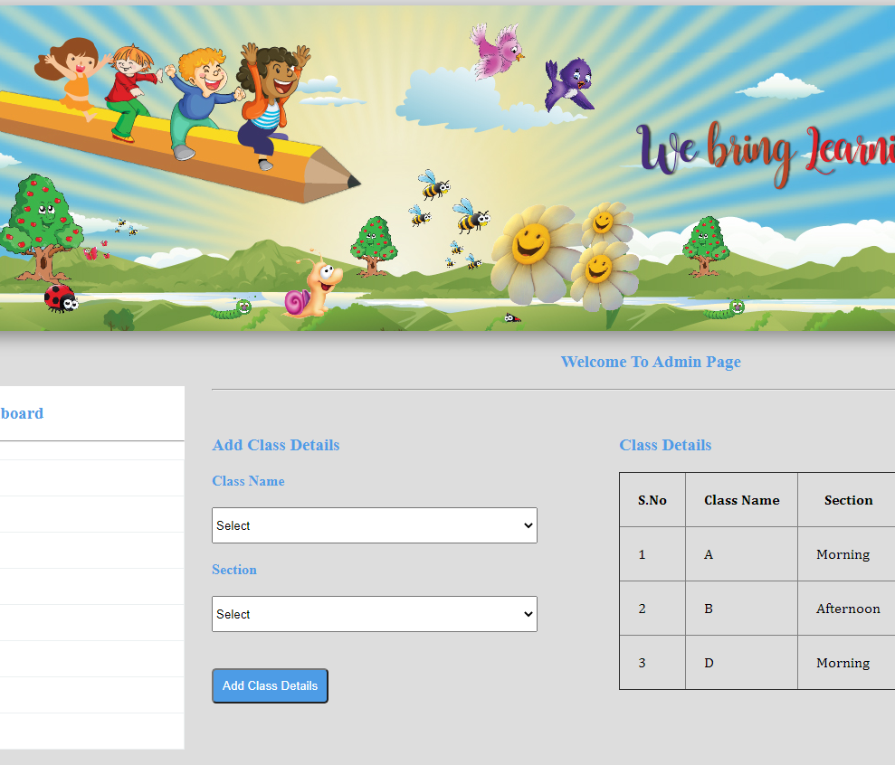
Feature
Add Class

Slide 9
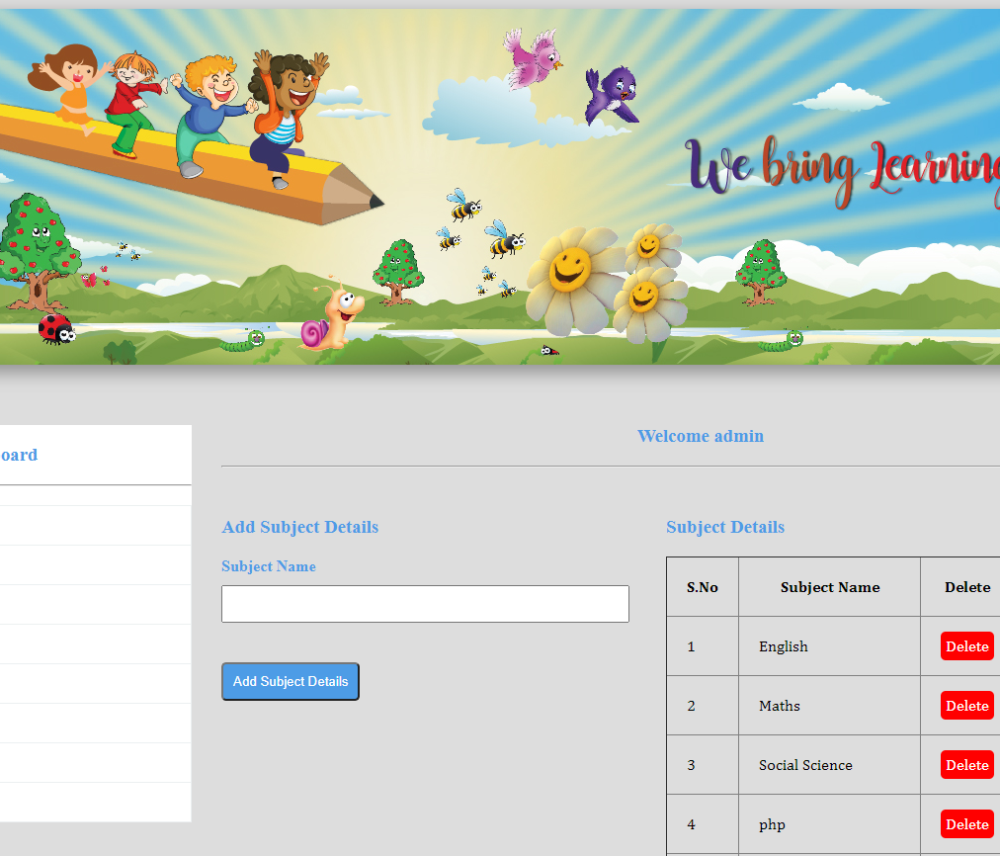
Feature
Add Subject

Slide 10
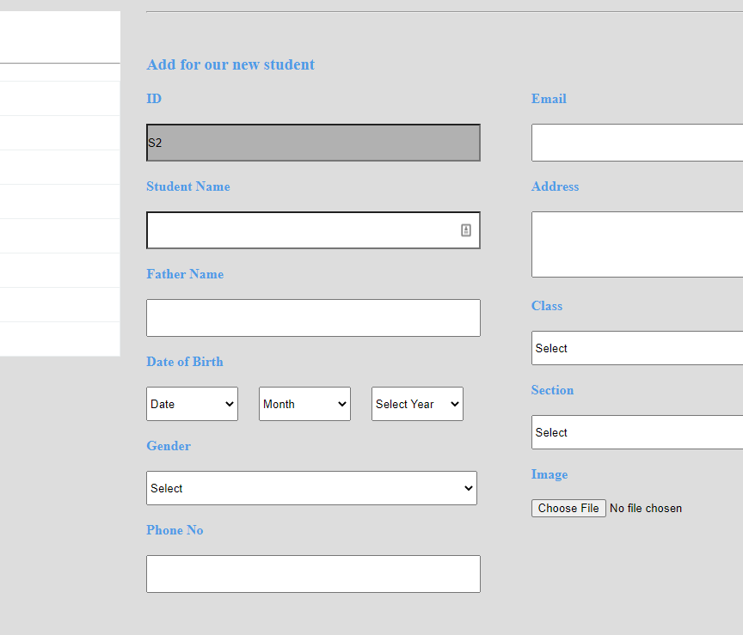
Feature
Add Student

Slide 11
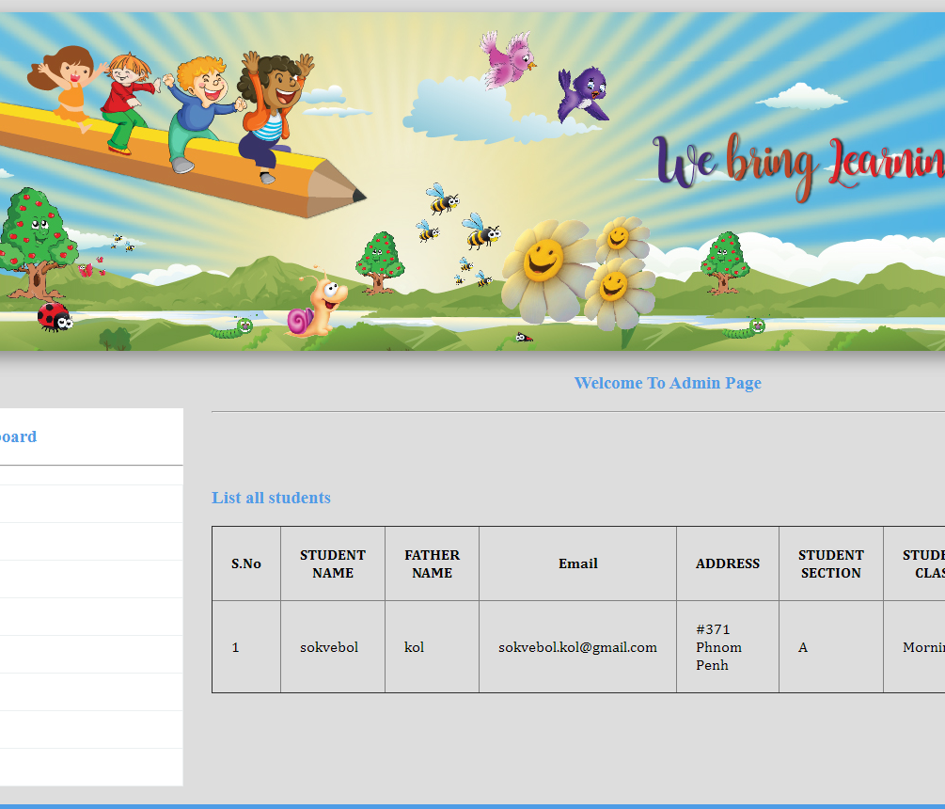
Feature
List Student

Slide 12
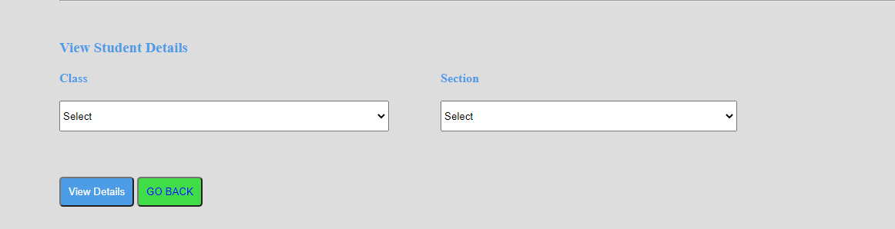
Feature
View Student
By Search

Slide 13
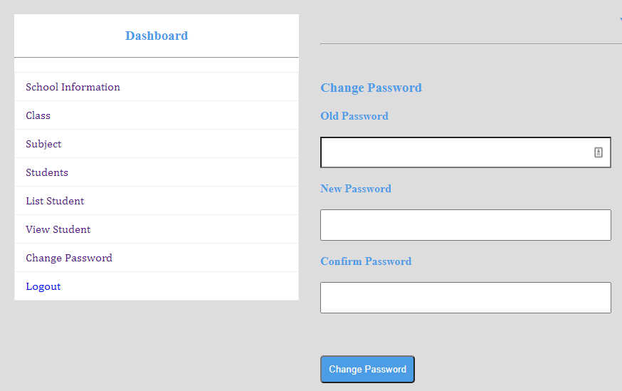
Feature
Change Password

Slide 14
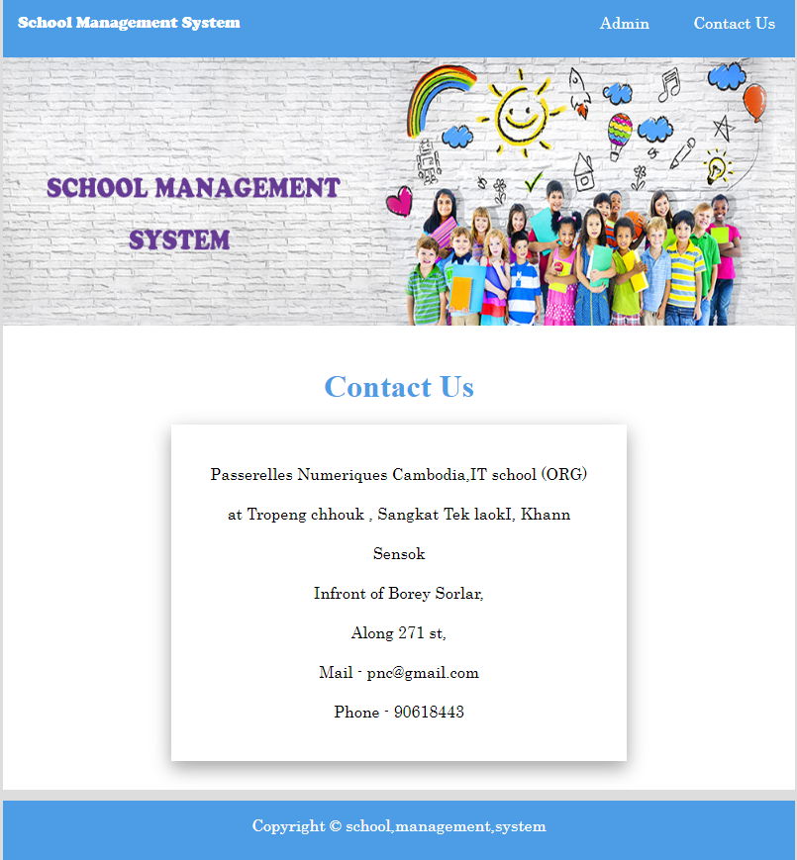
Feature
Contact Us

Slide 15




Technology
And Text Editor

Slide 16

Conclusion
Student Management System
Is the first system option for you to manage student daily task in Cambodia.
Operation CRUD
Class
Student
Subject

Slide 17
Thank you

